Slide 1
Summer Term 23 Safe-Reinforcement Learning for Self-Adaptive Systems Lecture-6:Underspecification and Causality
Prof. Dr. Holger Giese (holger.giese@hpi.uni-potsdam.de)
Christian Medeiros Adriano (christian.adriano@hpi.de) - “Chris”
He Xu, Sona Ghahremani, Mustafa Ghani, Iqra Zafar

Slide 2
Failure Modes [D’Amour 2020]
1- Structural Conflicts
Evidence: Solving the wrong problem
Impact: slow convergence, brittleness, sample inefficiency, etc.
Root-causes: Measurement error, Selection bias, etc.
BUG
Solution: follow ML best practices, e.g., more and better data, methods more robust to overfitting, i.i.d. evaluations (train-test-validation splits, cross-validation).
2- Under-Specification
Evidence: Solving a fragment of the problem
Impact: lack of robustness, unsafe actions, catastrophic forgetting, etc.
Root-causes: hidden confounders, spurious correlations, shortcut learning in neural nets, i.e., lack of causal grounding.
Untested code
Solution: sensitivity analysis, generalization to out-of-distribution, more informative priors, complementary baselines for comparison.
D'Amour, A., et al., 2020, Underspecification Presents Challenges for Credibility in Modern Machine Learning

Slide 3
Not a new problem but overlooked!
Underspecification is well-documented in the ML literature, and is a core idea in deep ensembles, double descent, Bayesian deep learning, and loss landscape analysis
Lakshminarayanan, B., 2017, Simple and scalable predictive uncertainty estimation using deep ensembles.
Fort, S., 2019, Deep ensembles: A loss landscape perspective.
Belkin, M., 2018, Reconciling modern machine learning and the bias-variance trade-off.
Nakkiran, P., 2020, Deep double descent: Where bigger models and more data hurt.
However, its implications for the gap between i.i.d. and the application-specific generalization are neglected.
Under-specification has downstream effects on robustness/safety, ethics/fairness, and causal grounding.
D'Amour, A., et al., 2020, Underspecification Presents Challenges for Credibility in Modern Machine Learning

Slide 4
Underspecification [D’Amour 2020]
Definition: An ML pipeline is underspecified when it generates predictors with equivalently held-out performance in the training domain, but that behave very differently in deployment.
Impact: poor model behavior, instability at deployment, lack of system reliability
Keywords: distribution shift, spurious correlation, fairness, identifiability,
Domains: computer vision, natural language processing, medical imaging, electronic health records, genomics
Example: The solution to an underdetermined system of linear equations (i.e.,) is under-specified, because
it has more unknowns than linearly independent equations
it represents an equivalence class of solutions given by a linear subspace of the variables.
D'Amour, A., et al., 2020, Underspecification Presents Challenges for Credibility in Modern Machine Learning
Notes:
[D’Amour et al. 2020 ] D'Amour, A., et al., 2020, Underspecification Presents Challenges for Credibility in Modern Machine Learning

Slide 5
Brief overview of causality and why it matters

Slide 6
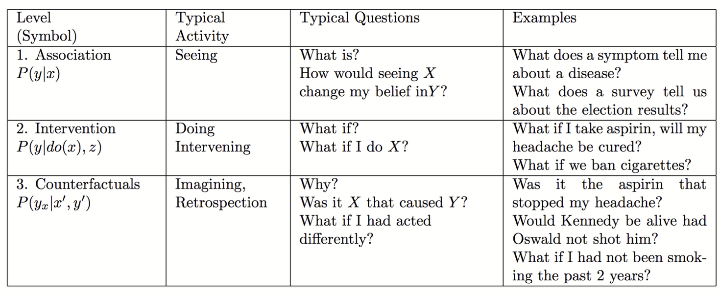
The Ladder of Causality [Pearl 2019]
Source: http://web.cs.ucla.edu/~kaoru/3-layer-causal-hierarchy.pdf
Pearl, J. (2019). The seven tools of causal inference, with reflections on machine learning. Communications of the ACM, 62(3), 54-60.

Slide 7

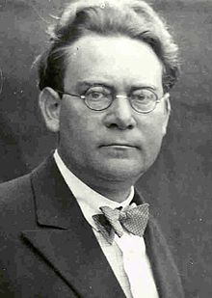
Reichenbach’s Common Cause Principle
Assume that X Y (X and Y are dependent)
X causes Y
Y causes X
There is a third hidden common cause
Combination all the above
In other words, “there is not correlation without causation”
Hans Reichenbach 1891-1953
Notes:
Latex code for the independence symbol - https://tex.stackexchange.com/questions/218631/symbol-for-not-conditionally-independent

Slide 8
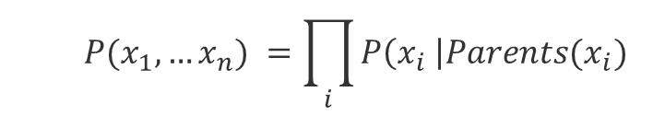
Markov factorization
$$P(x_{1},…x_{n}) =\prod_{i}{P\left(x_{i} \right|{Parents(x}_{i})}$$
Causal Markov kernels
If P admits the factorization relative to a DAG G, we can say that the DAG represents the probability function P, i.e., G and P are compatible or that P is Markov relative to G.
We can also say that the Graph G induces the probability P.
Notes:
Scheines, Richard. "An introduction to causal inference." (1997).

Slide 9
d-separation
X and Y are d-separated if all paths between X and Y are blocked by a set Z of nodes,
i.e., X ꓕ Y | Z
The blocking* situations are:
X
Z
Y
Pipe
X
Z
Y
Blocked only if conditioned on Z
X
Z
Y
Fork
X
Z
Y
Already blocked without conditioning on Z
Collider
*grey means blocked (usually by conditioning on it)
Notes:
Colliders, or Immoralities or v-structures

Slide 10
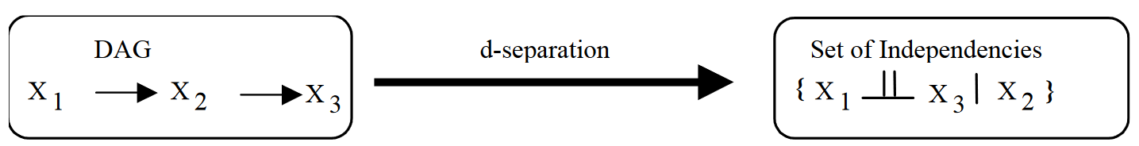
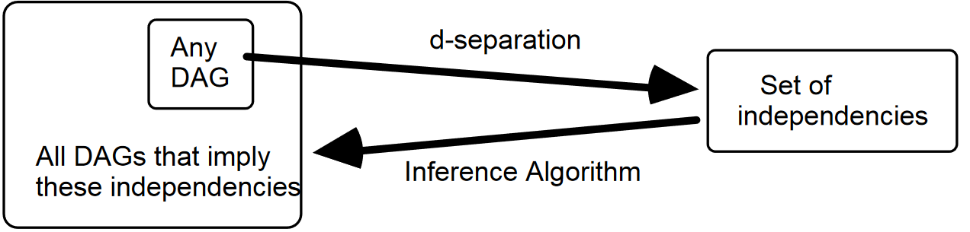
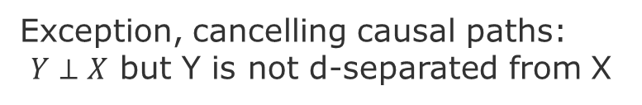
Faithfulness
If P(X₁,X₂,X₃) is faithful, then whatever the independencies that occur in P, they arise not from incredible coincidence, but rather from structure (a causal graph) [Scheines 1997].
Z
Exception, cancelling causal paths:
$Y⊥X$ but Y is not d-separated from X
X
Y
W

Slide 11
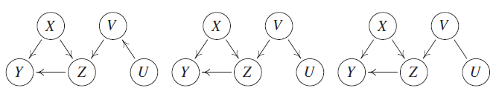
Markov equivalence classes
Graphs are equivalent if they have the same set of nodes and present the same colliders.
source: [Peters, Janzing & Schölkopf 2017]
Notes:
Causal Markov Condition relates statements about graph separation to conditional independences.
Note however, that different graphs can encode the same conditional independences.
https://en.wikipedia.org/wiki/Causal_Markov_condition
[Peters, Janzing & Schölkopf 2017] Peters, J., Janzing, D., & Schölkopf, B. (2017). Elements of causal inference: foundations and learning algorithms. MIT press.
[Hausman & Woodward 1999] Hausman, D. M., & Woodward, J. (1999). Independence, invariance and the causal Markov condition. The British journal for the philosophy of science, 50(4), 521-583.

Slide 12
The Seven Tools of causal inference [Pearl 2019]
Tool 1: Encoding Causal Assumptions – Transparency and Testability
Tool 2: Do-calculus and the control of confounding
Tool 3: The Algorithmization of Counterfactuals
Tool 4: Mediation Analysis and the Assessment of Direct and Indirect Effects
Tool 5: Adaptability, External Validity and Sample Selection Bias
Tool 6: Recovering from Missing Data
Tool 7: Causal Discovery
Pearl, J. (2019). The seven tools of causal inference, with reflections on machine learning. Communications of the ACM, 62(3), 54-60.

Slide 13
Sufficiency and Necessity

Slide 14
Sufficient and Necessary Conditions-1
If <antecedent> then <consequence>
A is sufficient for B = If A then B
A is necessary to B = If B then A, or If not-A then not-B (counter-positive case)
Example-1: If I have a driver's license, then I passed the driving test
Passing a driving test is a necessary condition for having a driver's license
Having a driver's license is a sufficient condition for having passed the driver's test (a bit awkward, but correct)

Slide 15
Sufficient and Necessary Conditions-2
Example-2: “A” being of a superclass is a necessary condition for “A” to be in a subclass of it.
Superclass == rectangle, Class == square
A == shape S being a square, B== shape S being a rectangle
If A (S is a square), then B (S is rectangle),
this implies that S being a square is a sufficient condition for S to be rectangle
If not B (S is not a rectangle), then not A (S is not a square),
this implies that S not being a rectangle is a necessary condition for it not to be a square

Slide 16
Sufficient and Necessary Conditions-3
Biconditional:
A is a necessary and sufficient for B
A if and only if B
(if A then B) and (if B then A)

Slide 17
Ladder of causality [Pearl 2019]
Layers | Use Cases
Layer-1 (Association /Prediction) | Given an input how to predict the outcome from the input? Inputs and outcomes are any measurable variable in the system. Uses: (1) allow to predict utility values from configuration values. (2) allow to predict environment outputs (observations) from inputs (also observations).
Layer-2 (Causation/ Intervention) | Given a certain intervention (sequence of actions), what is the probability of an effect of a certain magnitude? Uses: allow to estimate the effect of alternative actions so to evaluate how well a set of actions satisfy a goal.
Layer-3 (Counterfactual/ Reasoning) | Given a desired effect or probability of desired effect and contextual certain constraints (conditional values on certain covariates), which intervention (or sequence of actions) should I take OR how the various interventions rank Uses: allow to choose among different interventions when only the effect is known
Judea Pearl. 2019. The seven tools of causal inference, with reflections on machine learning. Commun. ACM 62, 3 (March 2019), 54–60. https://doi.org/10.1145/3241036

Slide 18
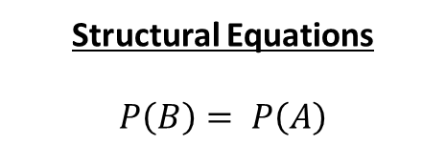
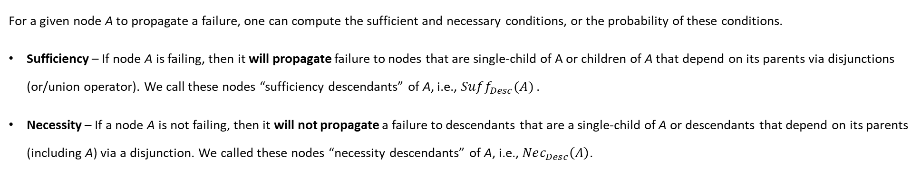
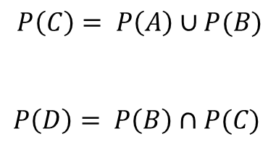
Sufficient and Necessary Conditions for Event Propagation
For a given node A to propagate a failure, one can compute the sufficient and necessary conditions, or the probability of these conditions.
Sufficiency – If node A is failing, then it will propagate failure to nodes that are single-child of A or children of A that depend on its parents via disjunctions (or/union operator). We call these nodes “sufficiency descendants” of A, i.e., $Suff_{Desc}(A)$ .
Necessity – If a node A is not failing, then it will not propagate a failure to descendants that are a single-child of A or descendants that depend on its parents (including A) via a disjunction. We called these nodes “necessity descendants” of A, i.e., $Nec_{Desc}\left(A\right)$.
Structural Equations
$$P\left(B\right)= P\left(A\right)$$
Sufficient and Necessary Causes
A is a necessary and sufficient cause of B
System Graph
B
D
A is a sufficient but not necessary cause of C
B is a sufficient but not necessary cause of C
B is a necessary but not sufficient cause of D
C is a necessary but not sufficient cause of D
A
$$P\left(C\right)= P\left(A\right)∪P(B)$$
$$P\left(D\right)= P\left(B\right)∩P(C)$$
C
Spatio-Temporal Dependency

Slide 19

Sufficiency Necessity Probabilities with Counterfactuals -I [Pearl 2019b]
Probability of Necessity
$$PN ≜ P\left({y′}_{x′}=False \right| x=True,y=True)$$
$$PN≜P\left({y′}_{x′} \right| y,x)$$
in other words, given that y and x happened, what is the probability that y would not happen if x does not happen?
Probability of Sufficiency
$$PS≜P\left(y_{x} \right| y’,x’)$$
in other words, given that y and x did not happen, what is the probability that y would happen if x happen?
Pearl, Judea. "Probabilities of causation: three counterfactual interpretations and their identification." Probabilistic and Causal Inference: The Works of Judea Pearl. 2022. 317-372
Notes:
Pearl, Judea. "Probabilities of causation: three counterfactual interpretations and their identification." Probabilistic and Causal Inference: The Works of Judea Pearl. 2022. 317-372.
Gomes, Gilberto. "Necessary and Sufficient Conditions, Counterfactuals and Causal Explanations." Erkenntnis (2023): 1-24.

Slide 20
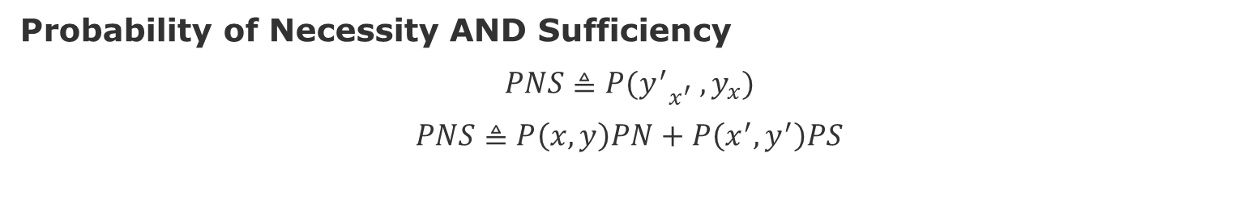
Sufficiency Necessity Probabilities with Counterfactuals -II [Pearl 2019b]
Probability of Necessity AND Sufficiency
$$PNS≜P{(y^{′}}_{x^{′}} , y_{x})$$
$$PNS≜P\left(x,y\right)PN+P\left(x^{′},y^{′}\right)PS$$
Pearl, Judea. "Probabilities of causation: three counterfactual interpretations and their identification." Probabilistic and Causal Inference: The Works of Judea Pearl. 2022. 317-372
Notes:
Pearl, Judea. "Probabilities of causation: three counterfactual interpretations and their identification." Probabilistic and Causal Inference: The Works of Judea Pearl. 2022. 317-372.
Gomes, Gilberto. "Necessary and Sufficient Conditions, Counterfactuals and Causal Explanations." Erkenntnis (2023): 1-24.

Slide 21
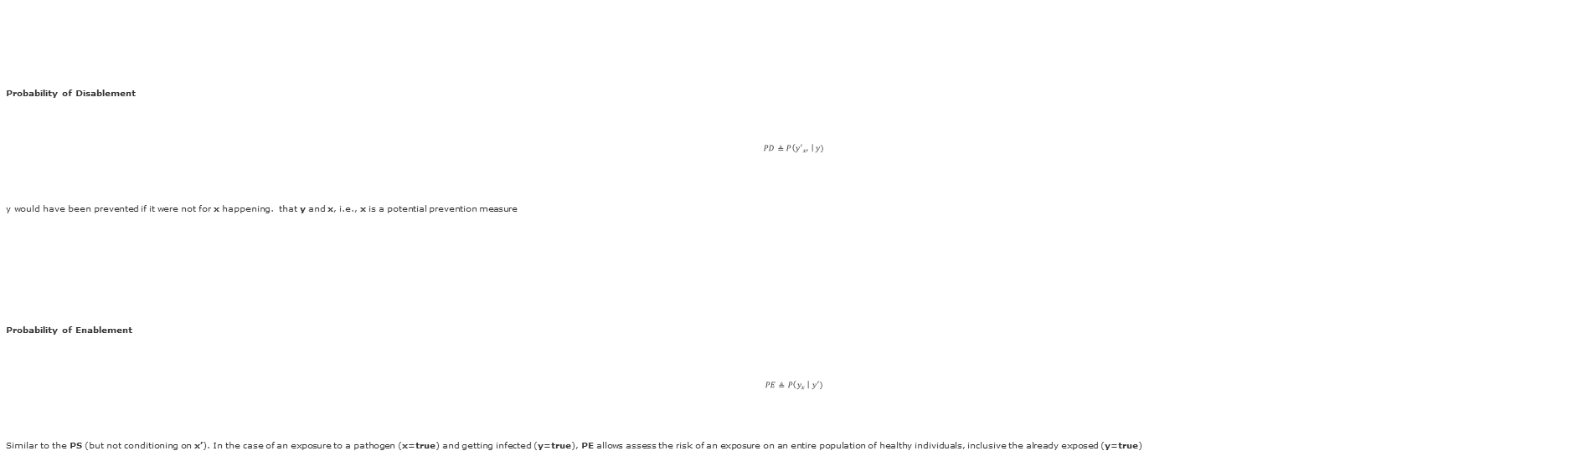
Sufficiency Necessity Probabilities with Counterfactuals -III [Pearl 2019b]
Probability of Disablement
$$PD≜P\left({y′}_{x′} \right| y)$$
y would have been prevented if it were not for x happening. that y and x, i.e., x is a potential prevention measure
Probability of Enablement
$$PE≜P\left(y_{x} \right| y′)$$
Similar to the PS (but not conditioning on x’). In the case of an exposure to a pathogen (x=true) and getting infected (y=true), PE allows assess the risk of an exposure on an entire population of healthy individuals, inclusive the already exposed (y=true)
Pearl, Judea. "Probabilities of causation: three counterfactual interpretations and their identification." Probabilistic and Causal Inference: The Works of Judea Pearl. 2022. 317-372
Notes:
Pearl, Judea. "Probabilities of causation: three counterfactual interpretations and their identification." Probabilistic and Causal Inference: The Works of Judea Pearl. 2022. 317-372.
Gomes, Gilberto. "Necessary and Sufficient Conditions, Counterfactuals and Causal Explanations." Erkenntnis (2023): 1-24.

Slide 22
Examples of misspecification

Slide 23
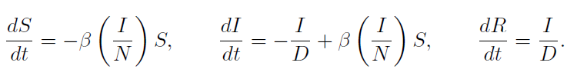
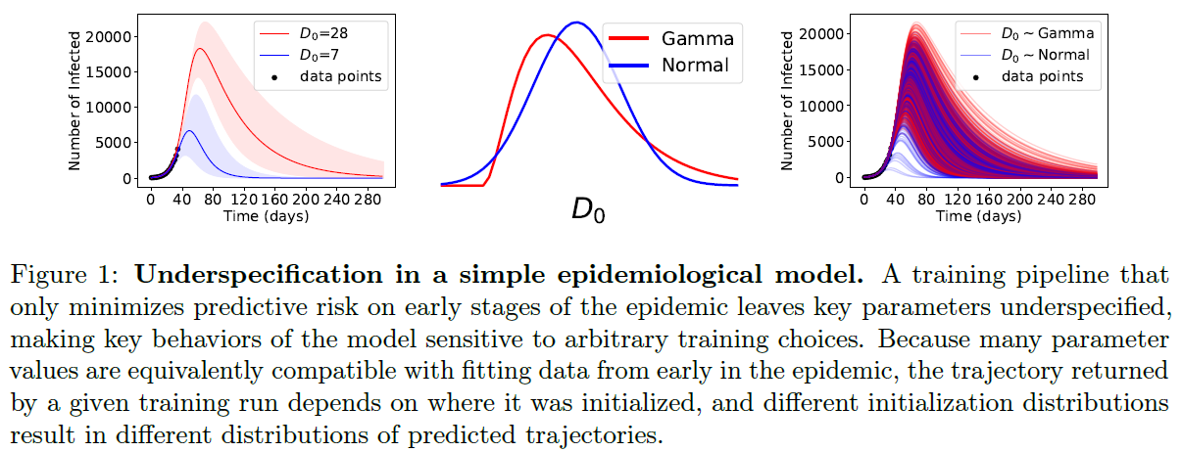
Example of Under-Specification [D’Amour 2020]
Epidemiological Model SIR
Which correspond to transmission rate (β), number of susceptible (S), infected (I), and recovered (R) individuals in a population of size N, and average duration of infection (D).
Simulate with different initializations for D (D₀) to generate a full trajectory from the SIR model for a full time-course T, but learn the parameters (β;D) from data of observed infections up to some time T_{obs} < T
Notes:
[D’Amour et al. 2020 ] D'Amour, A., et al., 2020, Underspecification Presents Challenges for Credibility in Modern Machine Learning

Slide 24
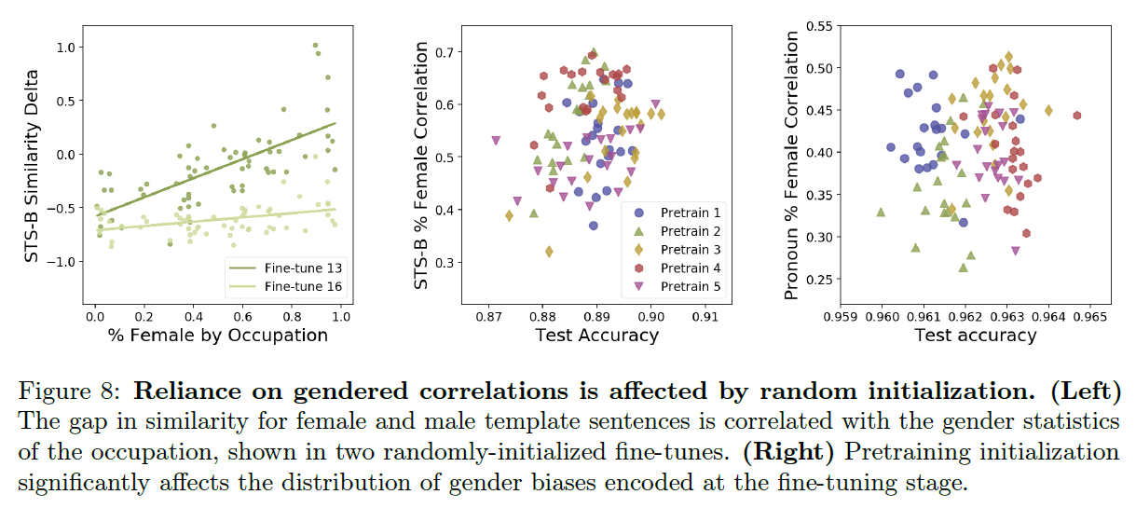
Gendered Correlations in Downstream Tasks [D’Amour 2020]
Gender-based shortcuts on two previously proposed benchmarks: a semantic textual similarity (STS) task and a pronoun resolution task “The engineer alerted the scientist that her design specifications were not compliant.”
similarity delta = sim(“a woman is walking”; “a doctor is walking”) - sim(“a man is walking”; “a doctor is walking”)
pronoun resolution task = a sentence with a pronoun that could refer to one of two possible antecedents (one is a profession), and the predictor must determine which of the antecedents is the correct one.
goal = how the sensitivy are predictions to gender signals? How similarity delta for each profession correlates with the percentage of women actually employed in that profession (U.S. Bureau of Labor Statistics [BLS; Rudinger et al., 2018).
Notes:
The linguistic cues in the template are sufficient to indicate the correct antecedent, but models may instead learn to rely on the correlation between gender and profession. In this case, the similarity delta is the difference in predictive probability for the profession depending on the gender of the pronoun.

Slide 25
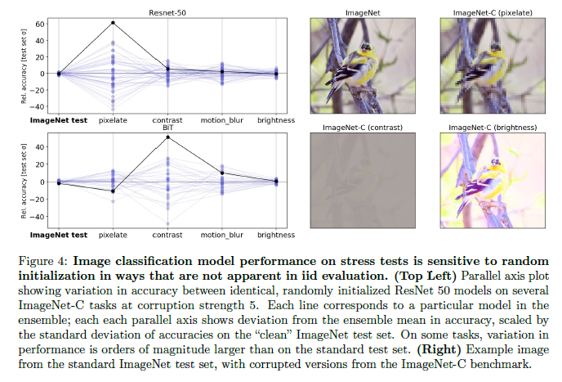
Image classification [D’Amour 2020]
Notes:
[D’Amour et al. 2020 ] D'Amour, A., et al., 2020, Underspecification Presents Challenges for Credibility in Modern Machine Learning

Slide 26
Fundamental Difficulties

Slide 27
Fundamental difficulty -1
Misalignment between the predictor learned by empirical risk minimization and the causal structure of the desired predictor(Schölkopf, 2019; Arjovsky et al., 2019).
source of misalignment spurious correlations (called shortcuts in Deep Learning) that are result of selection bias and hidden confounders
Usual approaches: use data collected in multiple environments to identify causal invariances:
Peters, J., et al., 2016, Causal inference by using invariant prediction: identification and confidence intervals. Journal of the Royal Statistical Society, 78(5):947–1012.
Arjovsky, M., et al., 2019, Invariant risk minimization.
Magliacane, S., et al., 2018, Domain adaptation by using causal inference to predict invariant conditional distributions, NeurIPS2018, pages 10869–10879.
However, these approaches do not always work!

Slide 28
Fundamental difficulty-2
Why might domain shift approaches not work?
Reason-1: they do not cover all cases where predictors trained to minimize predictive risk encode poor inductive biases. In many settings where ML excels, the structural issues identified above are not present.
Reason-2: usually, there is not enough information in the training distribution to distinguish between the inductive biases and spurious relationships, which are necessary to make the connection to causal reasoning,
Hence, this underspecified failure mode corresponds to a lack of positivity, not a structural defect in the learning problem.
The shortcut learning in deep neural networks stems from this difficulty. (Geirhos et al 2020)
Geirhos, R., et al., 2020, Shortcut learning in deep neural networks. arXiv preprint arXiv:2004.07780

Slide 29
Approach – Stress Test (Sensitivity Analysis)
Probe the model’s inductive biases on practically relevant dimensions—is sensitive to arbitrary, i.i.d.-performance-preserving choices, e.g., random seed.
A key point is that the stress tests induce variation between predictors’ behavior, not simply a uniform degradation of performance. This variation distinguishes under-specification-induced failure from the more familiar case of structural-change induced failure.
Procedure
Generate a suite of stress tests
Stratified
Shifted
Contrasted
Construct an ensemble of models
Confirm that i.i.d. performance if equivalent
Measure variation in the stress test performance

Slide 30
Solution – Stress Tests
Stratified Performance Evaluations
We choose a particular feature A and stratify a standard test dataset D' into strata D’_{a} = {(x_{i}; y_{i}) : A_{i} = a}. A performance metric can then be calculated and compared across different values of a.
Shifted Performance Evaluations
tests whether the average performance of a predictor f generalizes when the test distribution differs in a specific way from the training distribution. Specifically, these tests define a new data distribution P' <> P from which to draw the test dataset D', then evaluate a performance metric with respect to this shifted dataset There are several strategies for generating P' to test different properties of the predictor f.
For example, to test whether f exhibits invariance to a particular transformation T(x) of the input, one can define P' to be the distribution of the variables (T(x); y) when (x; y) are drawn from the training distribution P_{D}

Slide 31


Contrastive Evaluation [D’Amour et al. 2020 ]
Contrastive evaluation relies on a dataset of matched sets C
where each matched set z_{i} consists of a base input x_{i} that is modified by a set of transformations T
The evaluation metrics are computed with respect to matched sets and can include measures of similarity or ordering among the examples in the matched set.
For example, if one assumes that each transformation in T should be label-preserving, then a measurement of disagreement within the matched sets can reveal a poor inductive bias.

Slide 32
Contrastive Evaluation [D’Amour et al. 2020 ]
Common uses:
ML Counterfactual notions of Fairness (Garg et al., 2019; Kusner et al., 2017).
Garg, S., et al., 2019, Counterfactual fairness in text classification through robustness. In Proceedings of the 2019 AAAI/ACM Conference on AI, Ethics, and Society, pages 219–226.
Kusner, M. J., 2017, Counterfactual fairness, in Advances in neural information processing systems, pages 4066–4076.
NLP Robustness and Testing (Ribeiro et al., 2020; Kaushik et al., 2020).
Ribeiro, T., et al., 2020, Beyond Accuracy: Behavioral Testing of NLP Models with CheckList
Kaushik, D., et al., 2020, Learning the difference that makes a difference with counterfactually-augmented data. In International Conference on Learning Representations.
Notes:
[D’Amour et al. 2020 ] D'Amour, A., et al., 2020, Underspecification Presents Challenges for Credibility in Modern Machine Learning

Slide 33
Research Problems
1- Misspecification Problem
Goal: Show that different prediction models solve the task well for testing data, however, perform very differently in two distinct situations:
1.1 distinct hyper-parameters (prior knowledge)
1.2 out-of-distribution data (distribution shifts)
2- Value-at-Risk Problem
Goal: For a given policy, estimate:
2.1 risk of an unsafe action
2.2 impact of the unsafe action
3- Safety Problem
Goal: For a safety specification, enable training:
3.1 that is safe
3.2 that fine-tunes the safety specification
Detection
Measuring
Training

Slide 34
Specification Tasks – May-26
Write down your thoughts about the following questions:
How underspecification can create a safety problem/risk?
How to demonstrate underspecification?
test-data (offline data, replay buffer)?
distribution shifts that make training unsafe? How much shift (how to measure it)?
How to train distinct models that perform equally well on test data but are distinctly unsafe?
How to do you know if the models perform equally well on the test data?
How to do you know if two models are distinct?

Slide 35
END

